Slide 1
PIXIS
Global Handles and Fast Data Collection Examples Using a General Camera
These examples show the use of global handles and, in the data collection section, show how to collect data at high speeds into RAM. All examples use the global handle. The global camera handle should be opened only at the beginning of LabVIEW and then closed only before leaving LabVIEW.

Slide 2
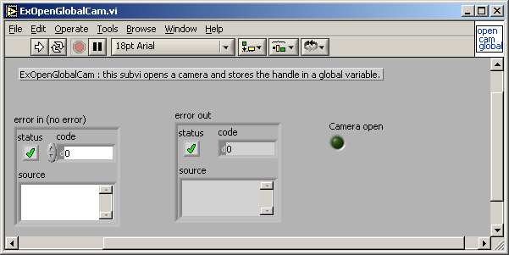
Open Toolkit and Camera
Open ExOpenGlobalCam.vi which can be found in your SIToolKit\LabView\Examplesxx_ver\Fast Examples\Open-Close Hardware folder. This only needs to be run once when you enter LabVIEW. Note the camera should be turned on and attached to the computer before this is run.

Slide 3
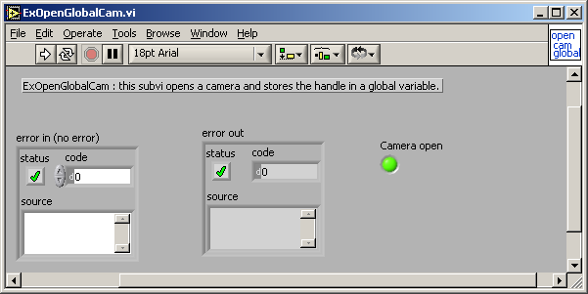
If the camera opens successfully you will get a green light in the LED on the front panel. There is now a global variable that holds the camera handle and camera open status for other programs to use.

Slide 4
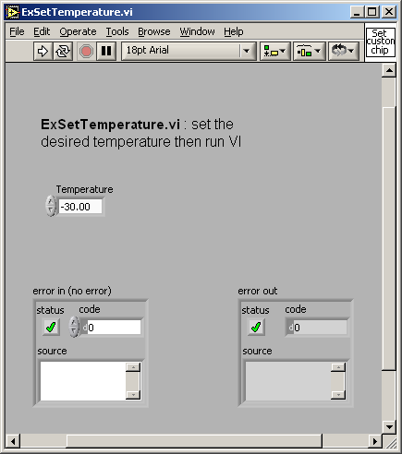
The Temperature can be set by the ExSetTemperature.vi

Slide 5
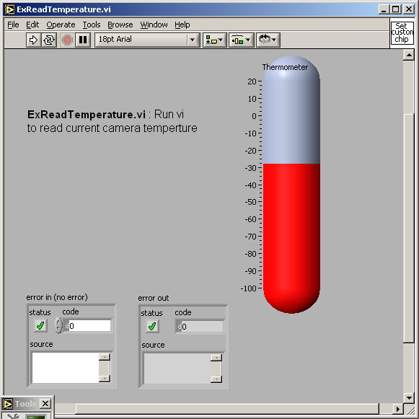
The temperature can be read with the ExReadTemperature.vi

Slide 6
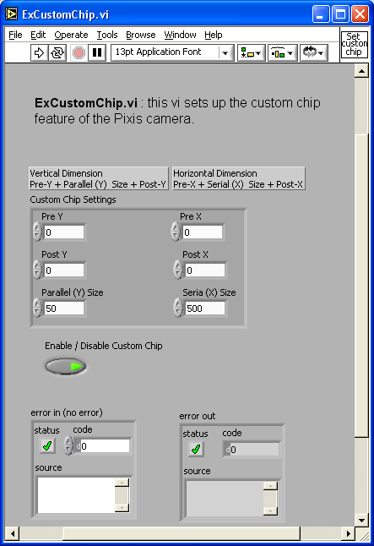
ExCustomChip.vi allows the software to define in the camera firmware the dimensions of the CCD chip. This can be used to gain speed by setting up the firmware to emulate a smaller CCD chip.

Slide 7
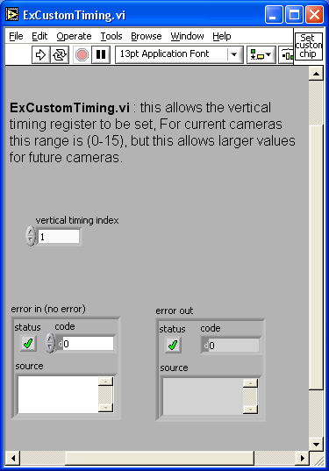
ExCustomTiming.vi allows the vertical clock timing to be set.

Slide 8
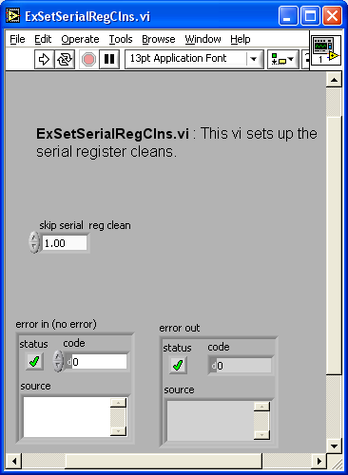
ExSetSerialRegClns.vi : this allows the serial register quick cleans to be set.

Slide 9
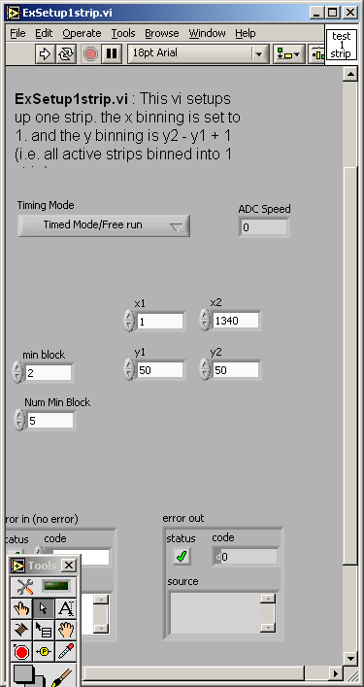
A single strip can be setup for data collection. This example takes an x1 and x2 for the start and end of the x axis (this is usually 1 to end of the CCD). The x binning is hard coded in the example to 1.
The y1 and y2 can also be entered, these are binned into 1 strip (i.e. y binning = y2 – y1 + 1).

Slide 10
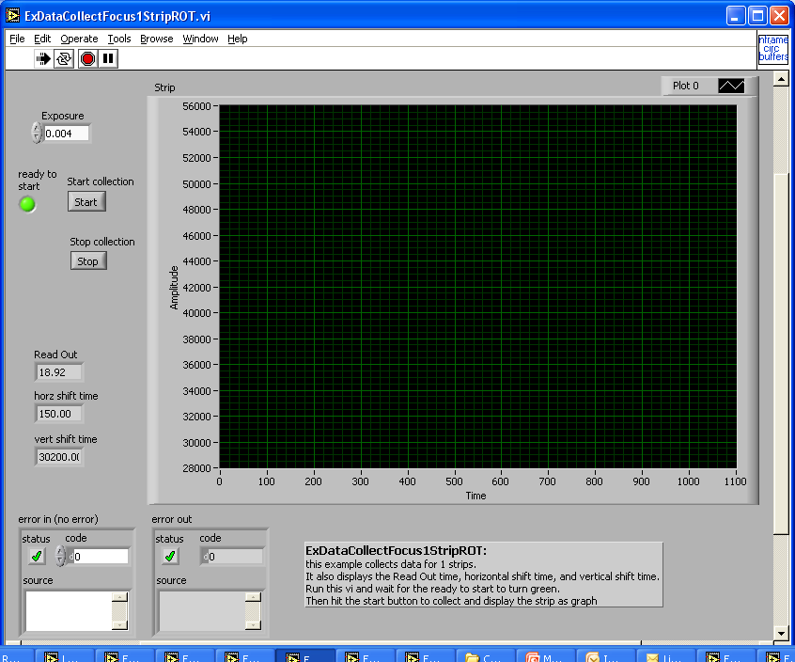
To focus a single strip run theEXDataCollectFoucs1StripROT.vi. Wait for the green ready light then hit the start button. Note the readout time and the horizontal and vertical shift times are displayed on the left side.

Slide 11
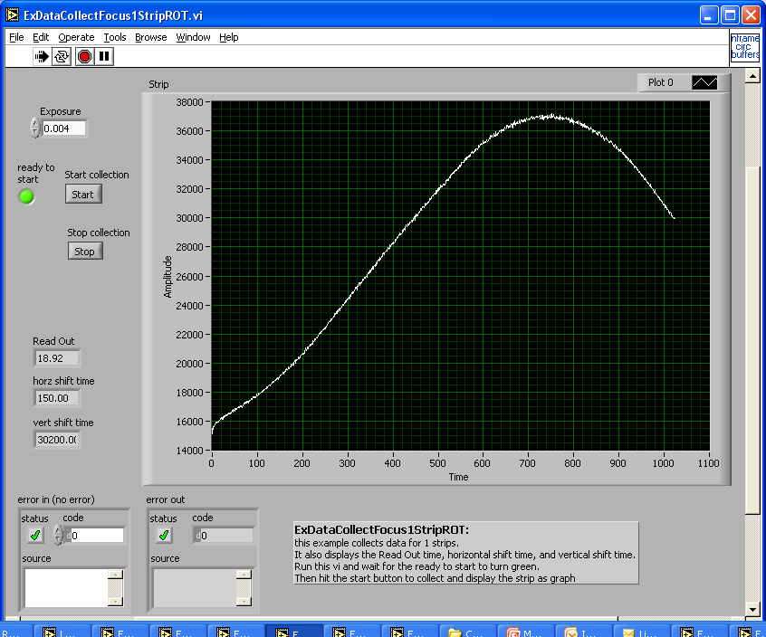
A graph should appear in the window when data collection starts. This will continue to update until the stop button on the front panel is hit.

Slide 12
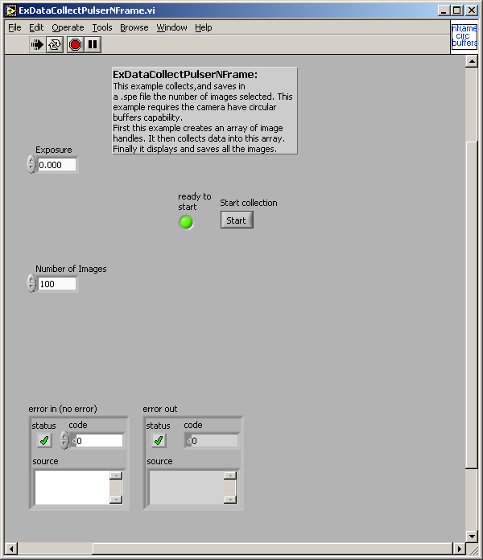
High Speed Data Collection
Run the ExDataCollectionPulserNFrame.vi This program is given a number of images to collect. It allocates enough buffer space in RAM (below LabVIEW in C++) to hold this amount and then uses only a 4 byte handle in LabVIEW for the actual data collection loop.
First wait until the “ready to start” LED is green then hit the start button. The data will be stored without display. When it is done a beep will sound and the program will then store the data into the file nframedata.
This example will run with any ROI setup (i.e. single strip, 2 strips, full image, ROI image, etc.)

Slide 13
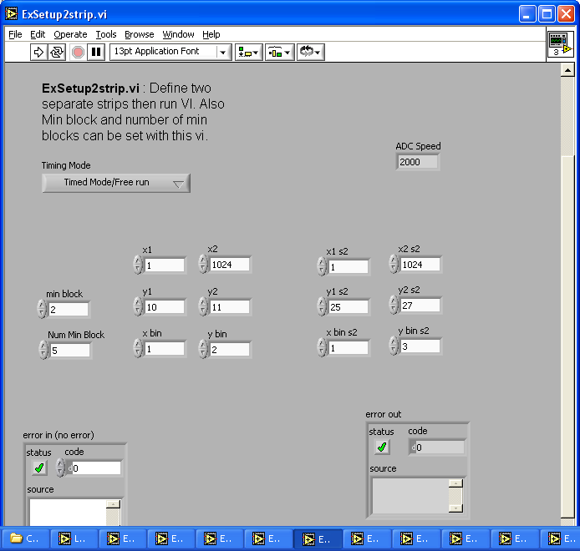
The ExSEtup2strip.vi example shows how to setup two strips (or ROIs)

Slide 14
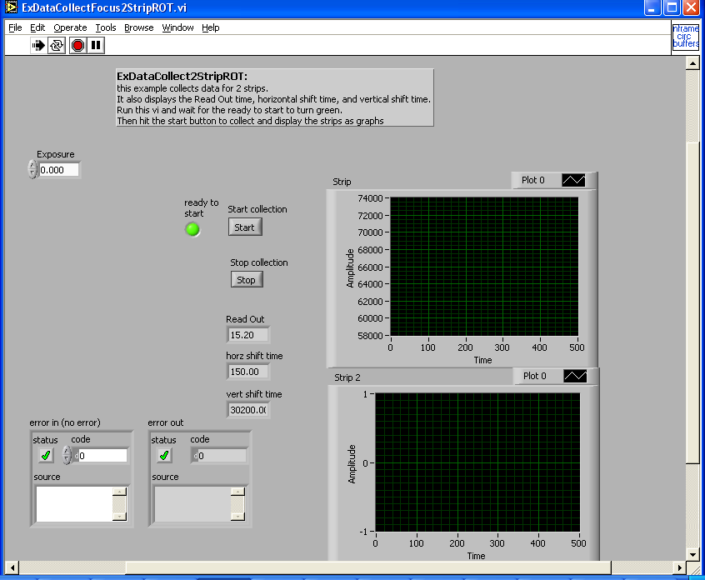
The ExDataCollectFocus2StripROT.vi shows how to collect and display 2 strips. Enter an exposure then run the VI. Wait until the “ready to collect” LED turns green then hit the start button.

Slide 15
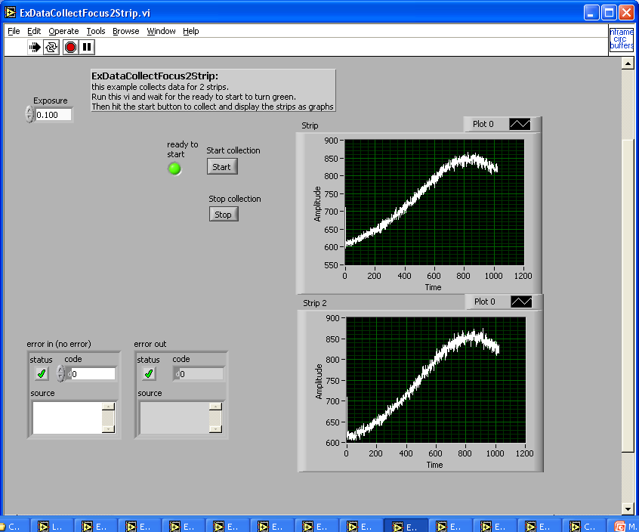
Two strips should be displayed and updated until the
stop button on the front panel is hit.

Slide 16
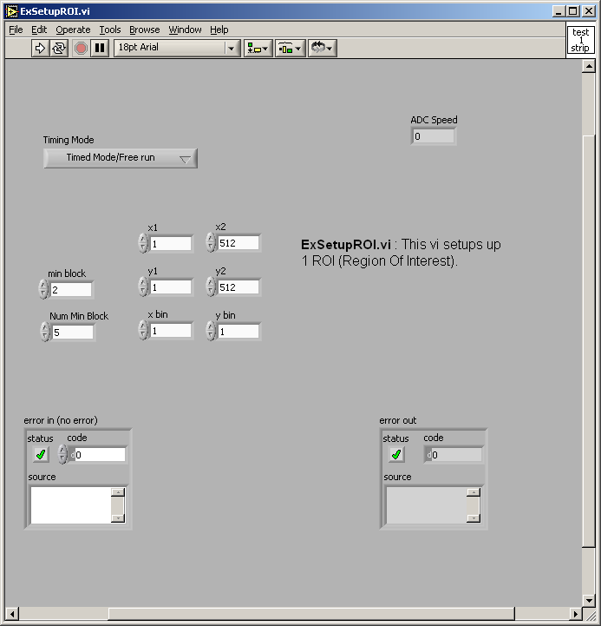
The ExSetupROI.vi shows how to setup an ROI image or a full image.

Slide 17
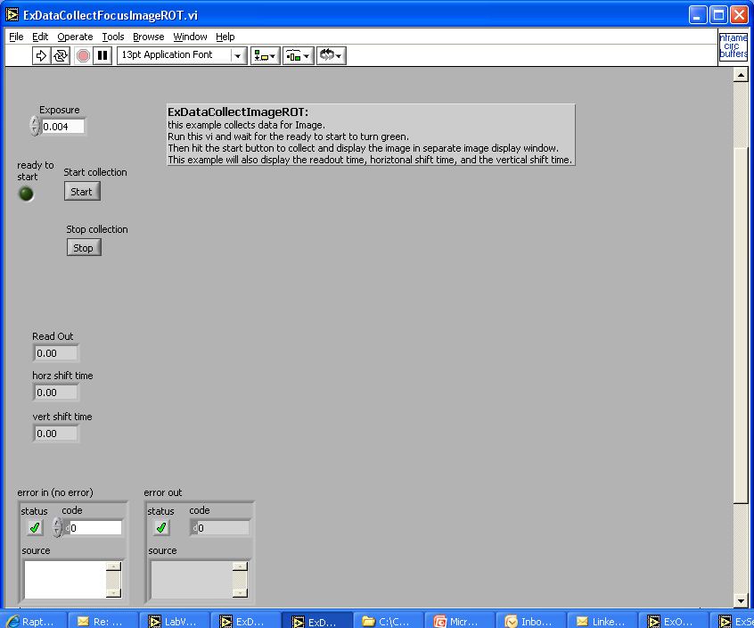
ExDataCollectFocusImageROT.vi collects an image into a separate floating window. Enter an exposure then run VI. Wait for the green LED then hit the start button

Slide 18
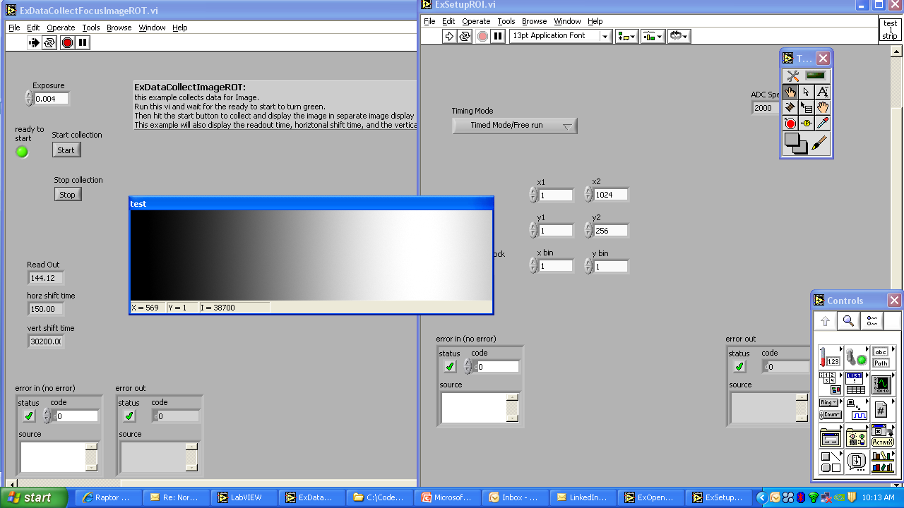
An image window will appear and be updated until the stop button on the front panel is hit, at which time the image window will disappear.

Slide 19
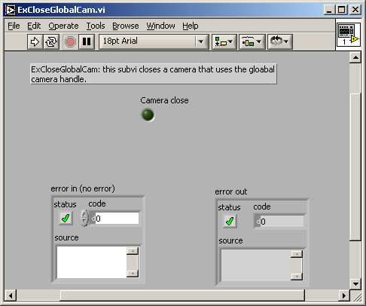
Close the Camera
Before leaving LabVIEW the ExCloseGlobalCam.vi should be run. This closes the camera, cleaning up any buffers allocated and closes the SITK® toolkit. Note that once this is run the camera handle is invalidated and the ExOpenGlobalCam.vi must be run to validate it again.

